Slide 1


Bank of Baroda Hackathon - 2022
Technology Partner
Team: Forza Analytica
Topic: Call Centre Analytics

Slide 2

Contents
Introduction
Problem Statement
User Segment and Pain Points
Competitive Products
2. Solution
Use cases
Solution Architecture
Azure Services to be used
Key Differentiator
Adoption Plan
3. Appendix

Slide 3

Introduction

Slide 4




Problem Statement
Everyday life now, versus a few months ago is starkly different. The COVID-19 pandemic has pushed business across verticals to take on challenges that they had never faced before. During the pandemic, industries have suffered severe blows with the news of travel bans, lockdowns and general public concern. The result has been a massive increase in customer service related volume. The continuous disruption of daily life has resulted in a 3x-4x increase in the number of inquiries. Messaging channels have been built to handle this amount of traffic.
And why did we decide to solve this problem?
During this time, agents faced repetitive queries, resulting in extended wait times and annoyed customers, leading to a bigger disaster: customer churn.
For any organization that provides any sort of product or services, It is important to create a connected, collaborative and consistent experience across the stakeholders involved.
For the organization to stay top of mind of customers as they make their choices, they will need a personalized, always on, proactive, well designed contact center and customer service model.
This additional pressure and shortage of staff due to pandemic, creates the risk of providing wrong information to customers, leading to compliance issues and inconsistent and degrading customer experience.
The event can change, but even during uncertain times businesses must act quickly, utilizing simple, yet powerful automation in order to reduce workload, increase efficiency, and in some cases, build work flows that are fully maintained by bots.

Slide 5







User Segment and Pain Points
Any industry which are involved in day to day customer handling and requires process management for the same will be the early adopter of our technology.
Some of them are as below:
The pain points of these industries which will require a call centre analytics based solution can be categorised into three parts, as below:
Customer Management Customer Satisfaction First Call Resolution Customer Retention Escalation Management Marketing and Sales Effectiveness | Agent Management Productivity Quality Management Compliance Management Training Opportunities areas | Process Management Business Strategy Deflection Strategy Areas of Improvement Competition Analysis
Banking, Financial Services and Insurance (BFSI)
E-Commerce Sector
Airlines Sector
Telecom Sector
Utility sector (Power, Water, Gas)
Product based B2B or B2C Companies

Slide 6



Competitive Products
Key Features
AI-Driven Conversational Themes
Root-Cause Analysis
Sentiment Analysis
Automated KPI calculations
Key Features
Omnichannel Collection
Speaker Separation
Sentiment Analysis
Secure redaction
Predictive Scoring
Key Features
Omnichannel Search, Discovery and Reporting
Root Cause Analysis
Sentiment Analysis
Related Phrases functionality
See Website
See Website
See Website

Slide 7
Proposed Solution

Slide 8
KPIs / Use Cases to analyze
Analyze the pitch and tone of the customers’ voice to understand the sentiment of the consumer.
Convert the customers’ voice files to text and analyze the expression, verbiage of the customers as the additional input
Combine the score of the voice sentiment and the text sentiment analytics to understand the complete Customer sentiment analytics
Rate the customers’ sentiment in 5-point scale or 3-point scale based on the data availability. Customer Master data can be used to draw the geographical inference on dashboard along with Word Cloud showing the major customer concerns. Number of abandoned calls in recent times shall be used as negative sentiment enhancer for a customer on dashboard
Customer Sentiment Analysis
Analyze the pitch and tone of the Agents and understand the quality of the conversation from the Company side and analyze the empathy towards the pain of the consumer
Convert the Agent voice to text to detect whether the greetings are in line with the branding
Analyze the call to understand whether the agent lets the consumer to express their grief
Analyze the call resolution capability of the agents
Agent Behavioral Analysis
Analyze the waiting time of the consumer during the call while agent is checking the records
Analyze the Overall call duration by agent and call category
Analyze the waiting time of the consumers at the IVRs before connecting the call to the customer care agents
Analyze the total waiting time spent by the consumers at IVR considering multiple attempts made by consumers before a through call
Call Resolution Delay Analytics
The call completion status and median call duration time shall be used to analyze how proficient the agent is in handling various IVR category calls
The initial and final customer sentiment during a call shall be used as an input to this assessment
The escalation and repetitive calls from the same customer on the same category shall be used as the tuning parameter
The fast / moderate / slow speaking agents shall be detected from the agent voice analysis and trained if required
Agent Skill Set analysis
The most chosen IVR path, the reason for most call dockets shall be an indicative parameter of customer’s pain
The feedback from social media data, feedback link shall be used to analyze the NPS of the customer
The response of the outbound calls from the Business shall be used as the interest / pain areas for the consumers
Analyze the customer footfalls at the physical centers as an additional parameter for customer segmentation
What’s on Customers' Mind

Slide 9


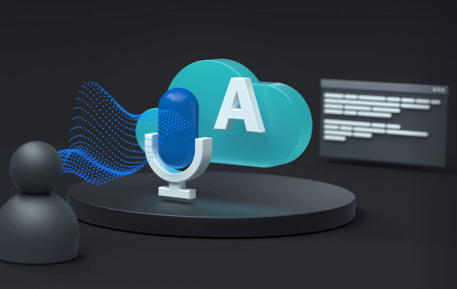



Consumer Sentiment Analysis
Consumer Address
Voice Sentiment Analysis
Consumer Voice
Customer Sentiment Analysis on 5-point scale
Text Sentiment Analysis
Azure Speech To Text Service
NLP Engine
Text Analytics
Word Cloud
Consumer Sentiment by Demography
Interactive Dashboard
Consumer Voice Transcripts

Slide 10


Agent Behavioral Analysis
Voice Sentiment Analysis
Agent Voice
3-point scale: Consumer can express his/her concern freely
Azure Speech To Text Service
Consumer Voice
Text Sentiment Analysis
Agent Behavioral Score Card
NLP Engine
Text Analytics
Call resolution status
Greetings as per the branding
Agent Voice Transcripts

Slide 11



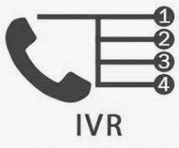

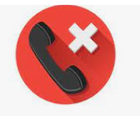

Call Resolution Delay Analytics
Agent Voice
Consumer Waiting Time
Call Resolution Delay Analytics
Dashboard
Voice File
Consumer Voice
Agent Conversation Duration
Time in IVR Queue
IVR Option Selection
Immediate Abandoned Calls at IVR
Immediate Abandoned Calls at Call Centre

Slide 12

Agent Skill Set analysis
Complaint Database
Call Duration
Voice
Escalation
Call Frequency
Azure Speech To Text Service
Agent Skill Set Analyzer
Customer Voice Initial & Final Sentiment
NLP Engine
Agent Speaking Speed
Call Completion Status
Voice Transcripts

Slide 13

What’s on Customers' Mind
Payment Regularity
Complaint Resolution
Competitors
Physical Centre Activities
Voice On Social Media
Outbound call Analysis
Most Chosen IVR Path

Slide 14

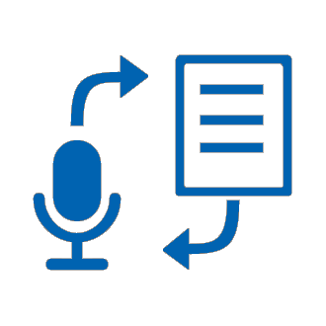



Azure Tools and Resources
Following Azure services will likely be required for developing our solution. These cloud services may also
help us develop our solution using a low code approach.
Azure Blob Storage
Azure Blob Storage SDK
Azure Language/Speech Service
Azure Speech SDK (Python)
Azure Text Analytics Service (Sentiment Analysis)
Azure Text Analytics SDK (Python)
Azure Cosmos Database
(For Storing Analysis Result As JSON)
Power BI to Visualize Data in Report

Slide 15
Key Differentiator
As the solution is developed as a SaaS product, large scalability is possible with minimal effort.
Solution can be available both on on-premise and cloud servers, which gives flexibility of usage.
Solution will support multiple file formats for processing the call recordings.
Functionality for supporting multiple Indian languages and accent as per regional needs.
Functionality for emotion detection with customized threshold levels, for individual conversations.
Functionality for analysis of conversation overlap and dead air time in the call recordings.

Slide 16
Adoption Plan
Proof of Concept
Solution Implementation
Monitoring
Hyper-Care Period
Approach
Benefits
Prototyping the product to ensure suitability of speech analytics, to achieve business objectives, based on available data.
Identifying solution components for the application to be implemented
Define a structure for the ongoing analysis/ monitoring. E.g. Frequency of calls, Sample size, additional data sources
Tuning the solution based on first hand customer experiences
Creation of strong Business case, before creating a solution.
Rationale driven business implementation approach
Reducing failure rates, by identifying the right objectives.
Improving stability of the solution product
01
02
03
04

Slide 17
Appendix

Slide 18
Resources
https://www.verint.com/speech-analytics/
https://callminer.com/products/eureka
https://www.nice.com/websites/analytics/cn/files/IA/Nexidia-Analytics.pdf
https://enthu.ai/blog/best-speech-analytics-software/
https://www.mckinsey.com/capabilities/operations/our-insights/how-advanced-analytics-can-help-contact-centers-put-the-customer-first
https://learn.microsoft.com/en-in/azure/cognitive-services/speech-service/
https://learn.microsoft.com/en-us/azure/cognitive-services/language-service/
https://learn.microsoft.com/en-in/azure/storage/blobs/storage-blobs-introduction

Slide 19
Thank You
Team Members
Ankan Bera
Aditya Maurya
Gaurav Ramakant Shirude
Panchalika Pal

